Slide 1
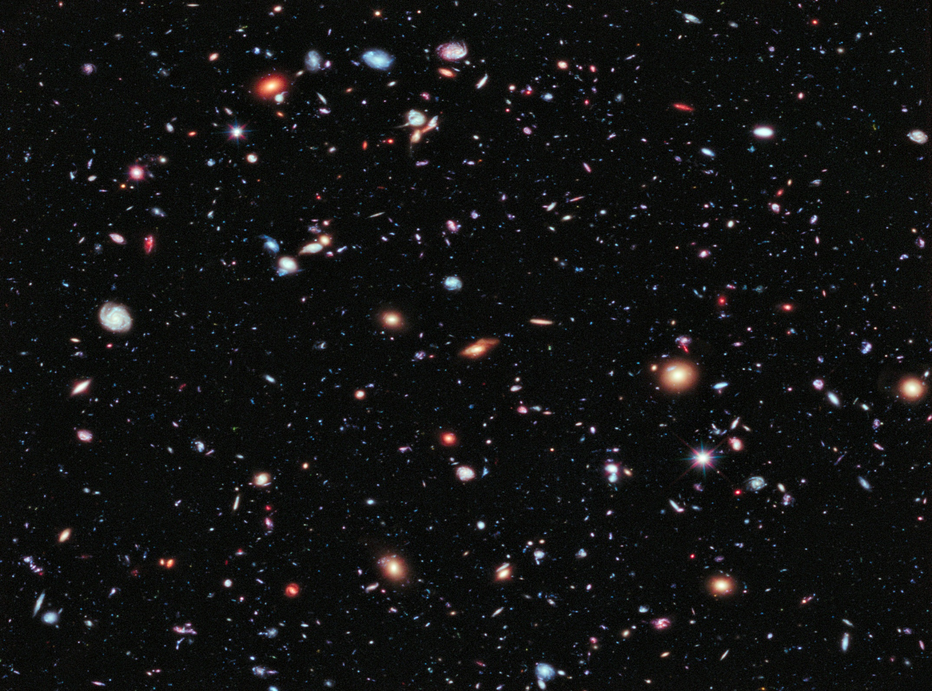

Slide 2
Lunar Regolith in the
Laboratory
Spectropolarimetry on Apollo
Moon Dust
W E Martin, J H Hough
Centre for Astrophysics Research
Centre for Atmospheric and Instrumentation Research
STRI

Slide 3
The Samples
10084 Apollo 11 part of five scoops of material gathered from close to the Lander -Sea of Tranquility (Mare, 'slight bluish tint' in photographs)
Apollo 12 about 35m from the Lander [two samples]
-Ocean of Storms (Mare)
15251 Apollo 15 from the rim of a 1 meter crater on the lower slopes of the Apennine Front -Hadley/Apennine (Mare but close to mountains)
66081 Apollo 16 collected from a small subdued crater on the Cayley Plain near Stone Mountain -Descartes Highlands
70161 Apollo 17 from a fillet of sediment banked against the east base of a boulder -Taurus-Littrow (Highlands)
Other: 1913,1980 eruptions, Mt Hekla, Iceland. Mt Etna, Sicily 2011

Slide 4
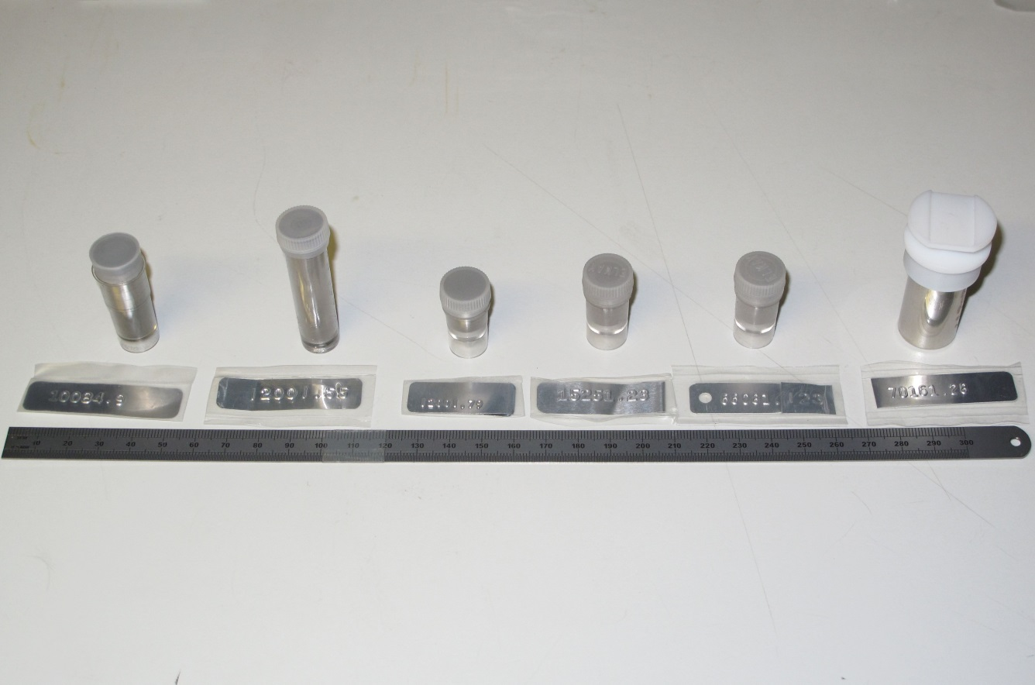
Lunar Regolith Samples

Slide 5
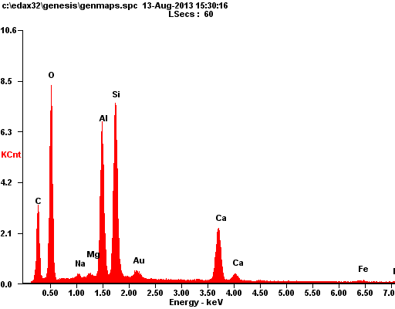
SEM Scans of Residue - 15251, 66081

Slide 6
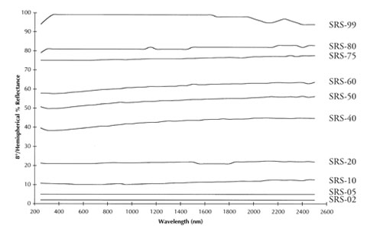
Spectralon Standard
Broadband Reflectance and Narrow Band Spectropolarimetry
We used a standard diffuse reflecting material to make relative measurements with the samples. Spectralon is nearly a perfect Lambertian diffuse reflector from 200-2000nm.

Slide 7
Broadband ~45 degree Incidence Tests

Slide 8
Lunar and Terrestrial Material Comparison

Slide 9
Broadband, ~45 degree Reflectance
Fibre Spectrometer Measurements ~0.2NA
With a broadband Tungsten-Halogen light source and the Spectralon white diffuse reflecting standard, the Lunar samples are seen to be more reflective at the red end of the spectrum and only about 10-20% overall of a white Lambertian material.
The notional 'Mares are dark and highlands are light' doesn't seem to hold with what we have. The 'brightest' material, 66081, is highland but the second brightest is 15251 which is maria material. The Apollo 17 highland dust is dark and lies with the rest of the maria material.

Slide 10
Narrow-band ‘Zero Incidence’
Spectropolarimetry
Modified Stokes Polarimeter
Uses Pellicle to obtain zero-angle scattering with vertical incidence.
Requires three metal mirror reflectors
Calibration using conventional matrix corrections with standards
Component achromaticity very difficult to achieve and requires individual settings for each major component per wavelength
Best compromise achieved by using measured ratio comparisons with a Spectralon standard reflector

Slide 11
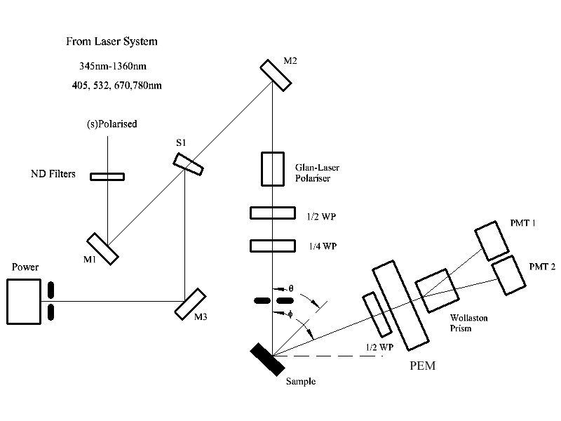
The Experiment Schematic Diagram

Slide 12
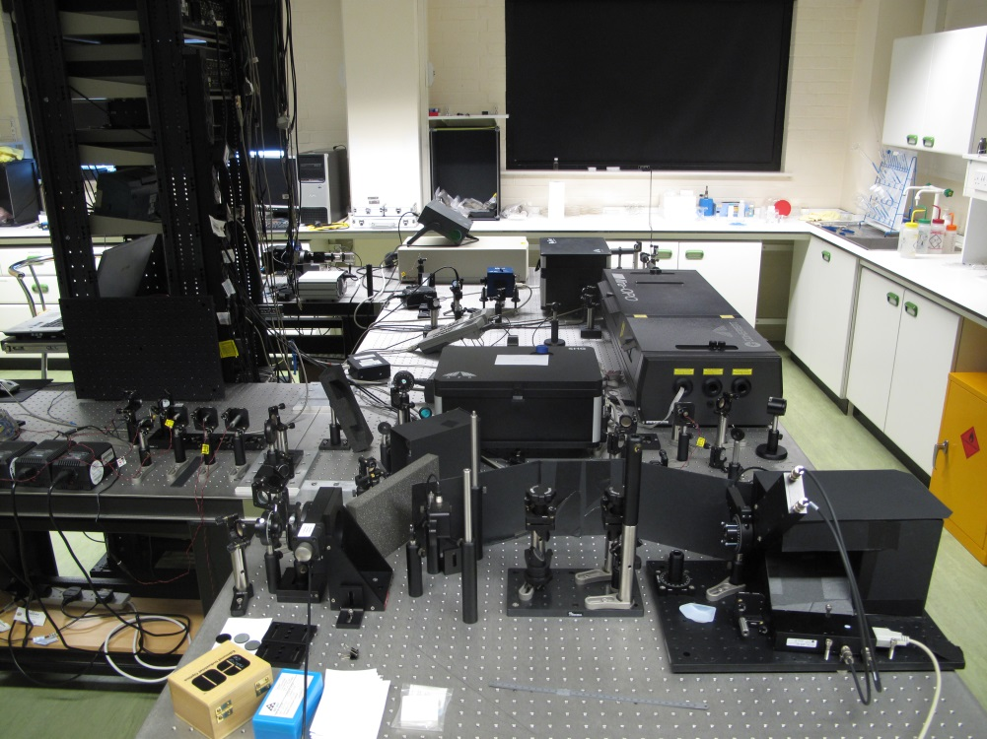
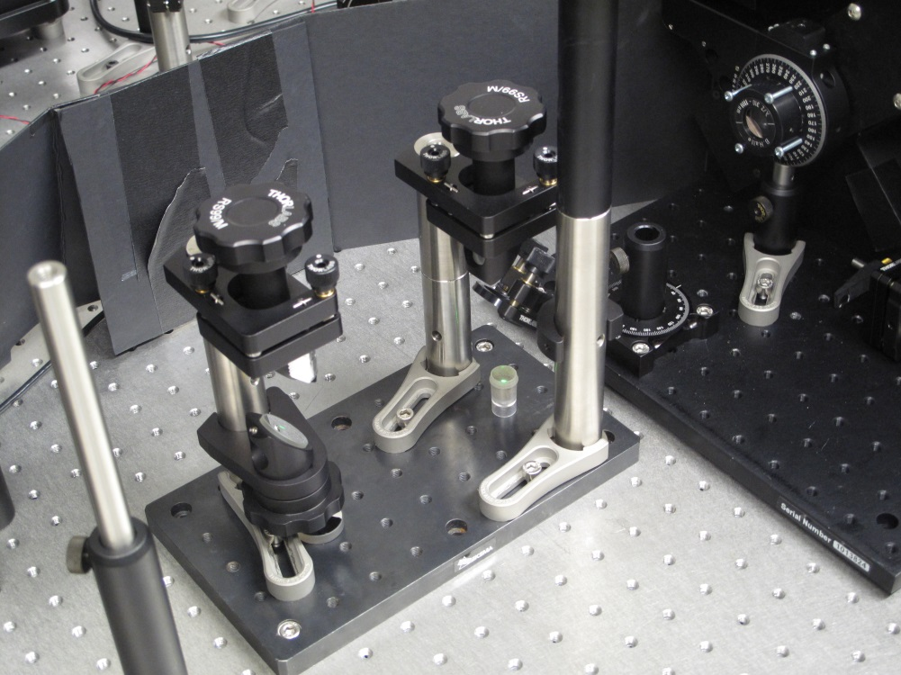
The Test Apparatus
Spot size at the sample = 3mm
Collection Solid Angle = 1.1e-4 sr

Slide 13
Spectralon Stokes Backscattering
Absolute Backscattering Coefficients at 11.5 deg Incidence

Slide 14
Narrow-band ‘Zero Incidence’ Spectropolarimetry

Slide 18
Conclusions
Regolith is... grey...reddish grey.
Volcanic samples from Earth are similar but have lower albedo.
The zero-incidence polarimetry data show that all samples
have higher relative Stokes component scattering than a diffuse reflector.
There is evidence of unpolarized to linear scattering even at a zero-incidence phase angle.
Unpolarized and linear to circular scattering is small.
The observed circular polarization components are consistent with multiple scattering from larger grains in the terrestrial samples
Correlation with grain sizes, shapes may be useful
IR measurements to be repeated and backscattering versus angle will be attempted without decanting.

